Slide 1
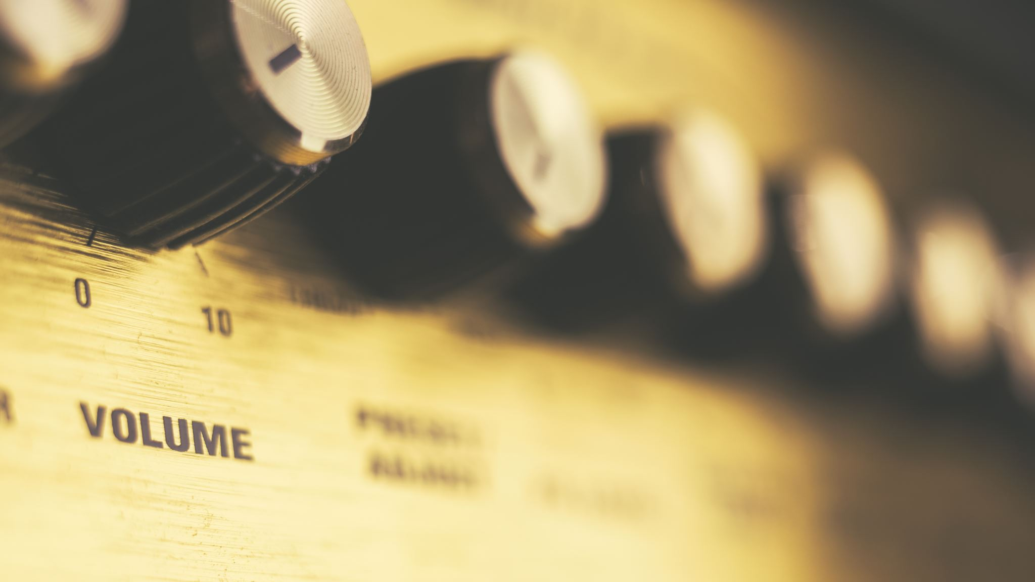
Song Generator

Slide 2
Contents
Pre-processing task for Taylor swift lyrics dataset
GPT-Based transformer decoder model – Causal Language Modelling
Greedy Decoding vs Minimum Bayes Risk Decoding Text Generation
BLEU-Score based Performance metric
Inference API
Docker File
Bonus Task:- Album Cover Generator (Conditional GAN)

Slide 3
Pre-processing Modules:-
Convert to lowercase
Remove numbers
Remove first sentence
Remove 'Embed' in last sentence
Replace \n with "<newline>“ TAG
Remove all extra spaces

Slide 4
Modelling Techniques:-
Causal Language Modelling (GPT2)
Transformer Decoder Mechanism
performs well in natural language generation task
Other very standard model BERT is more suited (still bit debatable) to a natural language understanding. That is based on Transformers encoder architecture, Sentiment Analysis.
T5 – Transformer Encoder-Decoder could be tried out in current case with slight modification in dataset

Slide 5
Decoding Technique:-
Explored two decoding techniques
Greedy Decoding
Choose the best possible candidate generation (by choosing the best possible work at each iteration)
Minimum Bayes Risk Decoding
A technique that can be used to generate more flexible and possibly more accurate results in tasks like machine translation and speech recognition by considering the probabilities of a range of potential outputs rather than just the single most likely one.
Generate several candidates and choose the one which has highest average similarity (BLEU or ROGUE or edit distance) with all other candidate generations.
It would increase the inference time, but overall performance will be improved

Slide 6
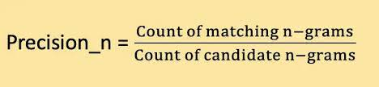
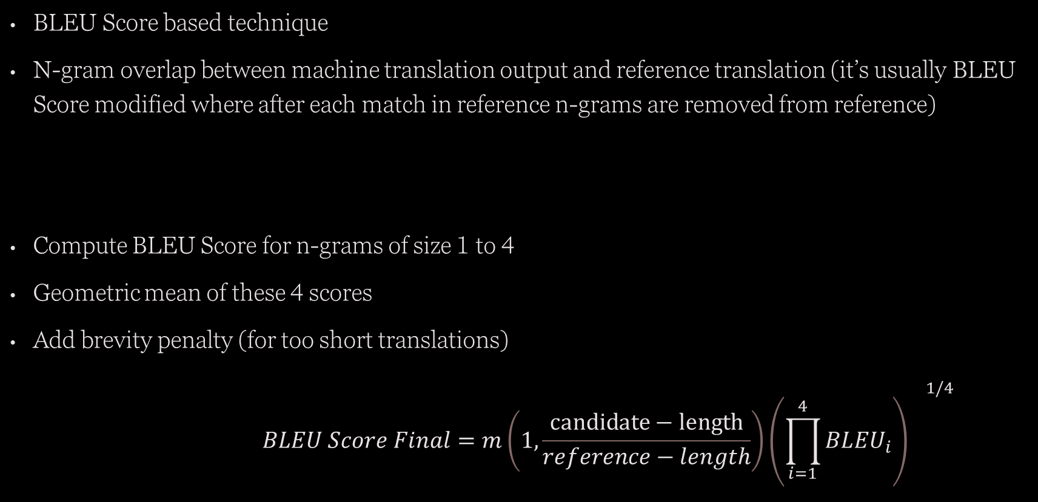
Performance Metric:-
BLEU Score based technique
N-gram overlap between machine translation output and reference translation (it’s usually BLEU Score modified where after each match in reference n-grams are removed from reference)
Compute BLEU Score for n-grams of size 1 to 4
Geometric mean of these 4 scores
Add brevity penalty (for too short translations)
$$BLEU Score Final=m\left(1,\frac{candidate−length}{reference−length}\right){{\left(\prod_{i=1}^{4}{BL{EU}_{i}}\right)}^{}}^{1/4}$$

Slide 7
Results:-
Not clear to me:- what does 2-3 verses of song as input means? All these results are generated based on an assumption that 2-3 verses means 2-3 lines.
BLEU Score for 100 elements in Test dataset.
Greedy Decoding
Avg. BLEU :- 32.62 (38.9 with 10 initial lines as an input)
MBR Decoding (with 10 candidate translations)
Avg. BLEU :- 35.02 (40.4 with 10 initial lines as an input)
Also, we need to fine-tune or explore several values for temperature variable in MBR decoding which decides how much randomness are we allowing, overall performance will depend on this
Note:- See Appendix for general understanding of BLEU Score

Slide 8
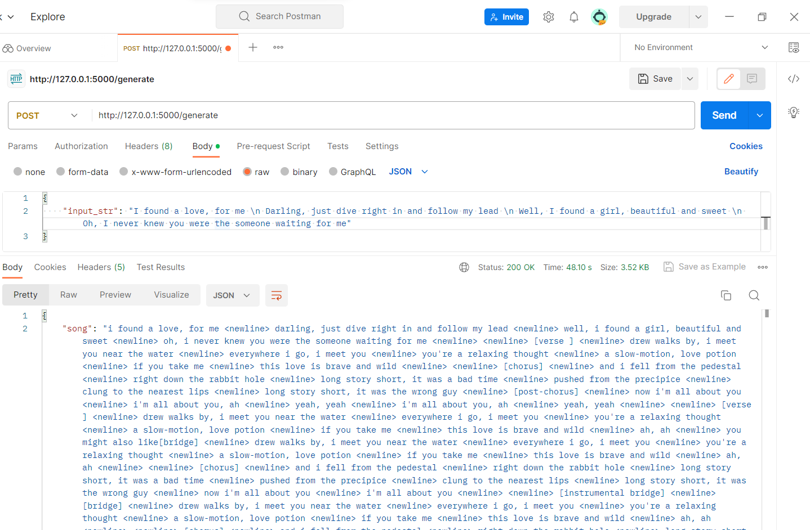
Inference API
Used Flask to expose the model as an API and then containerised the code into a Docker container.
POST method option to take input and generate output
GET method option to test the working of model
Used Postman to test the API to generate the “Ed Sheeran Perfect Lyrics” by our model.
Attached the Dockerfile as well as part of the deliverable.
Couldn’t actually run that Dockerfile in my system due to unavailability of the software.

Slide 9
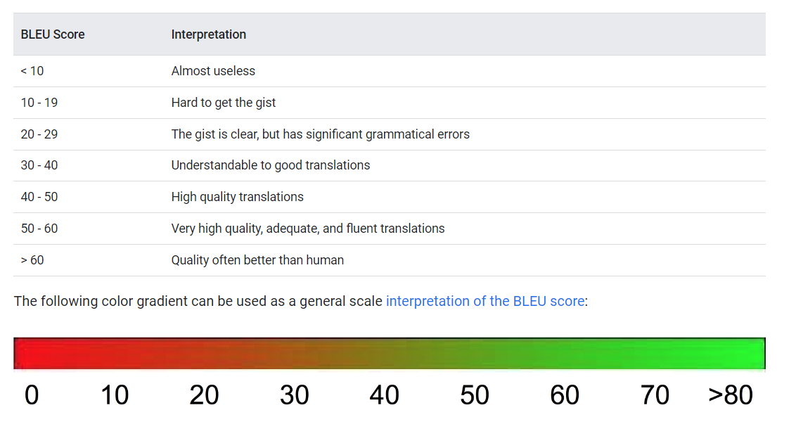
Appendix 1 –BLEU Score Rough understanding (Google Cloud)

